Slide 1
Babylon and Beyond
History 1310
Dr. Driggers

Slide 2
Orientation
Syllabus—any last questions? Keep asking them?
Survey of history of science, technology, medicine &c. throughout greater Mesopotamian history
General Details, geography, &c.

Slide 3
Theoretical Point
Where SHOULD we start this class???
The power of narrative
Keep reading!
Problem with Near Eastern Studies—Far East Studies???

Slide 4
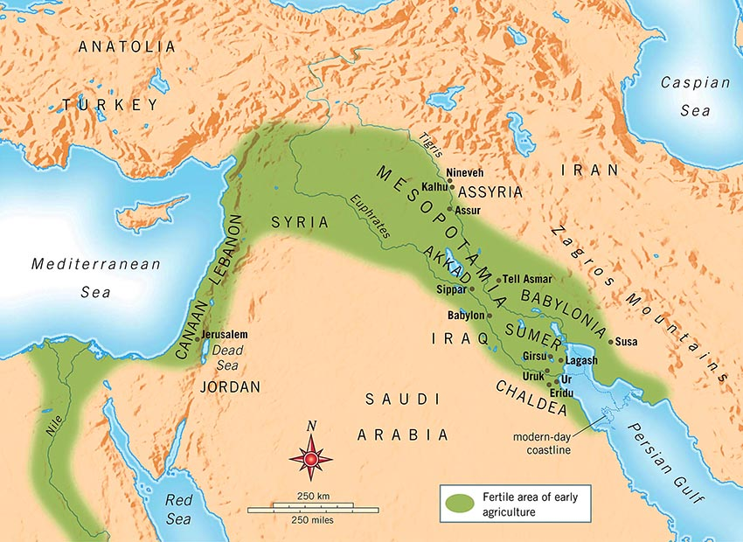
Geographic Location

Slide 5
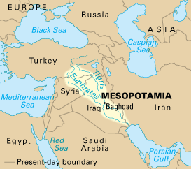
Framed in Today’s Geopolitical Landscape

Slide 6
Home to Diverse Groups of People
Sumerians
Akkadians
Persians
Babylonians
Assyrians
[Some of the World’s Oldest Societies]

Slide 7
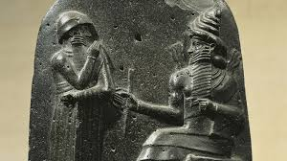
Hammurabi and his Code

Slide 8
Excerpt from the Code
If any one finds runaway male or female slaves in the open country and bring them to their masters, the master of the slaves shall pay him two shekels of silver.
If any one is committing a robbery and is caught, then he shall be put to death.
If a tavern-keeper (feminine) does not accept corn according to gross weight in payment of a drink, but takes money, and the price of the drink is less than that of the corn, she shall be convicted and thrown into the water.
If a son strike his father, his hands shall be hewn off.
If a man knock out the teeth of his equal, his teeth shall be knocked out.
If a barber, without the knowledge of his master, cut the sign of a slave on a slave not to be sold, the hands of this barber shall be cut off.
If a slave says to his master: "You are not my master," if they convict him his master shall cut off his ear.

Slide 9
Timeline
Goes back to 3500 BC
Civilization arose around present day Iraq
Communicated through a written language: cuneiform

Slide 10
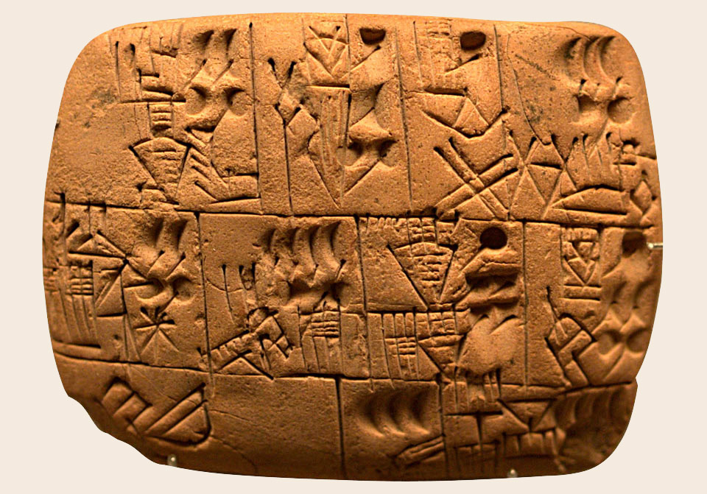
Cuneiform

Slide 11
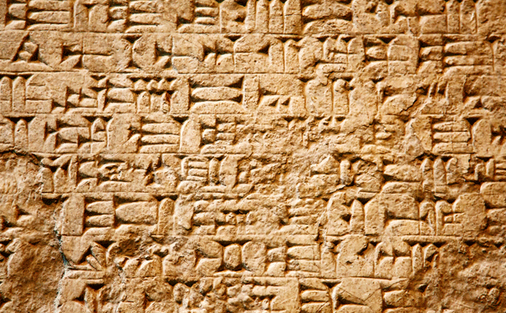
Cuneiform

Slide 12
Literature: The Epic of Gilgamesh
Written around 2100 BC
About 12 Books, or about 5 epic poems
About a King looking for eternal life, struggles through life, and challenging the power of the Gods
“He saw the Secret, discovered the Hidden, he brought information of (the time) before the Flood. He went on a distant journey, pushing himself to exhaustion, but then was brought to peace.” (1.5-8)

Slide 13
Technological Achievement
Metalworking (Bronze, Cooper, Gold, and evnetuall iron)
Glassmaking
Textile Weaving
Water storage/control

Slide 14
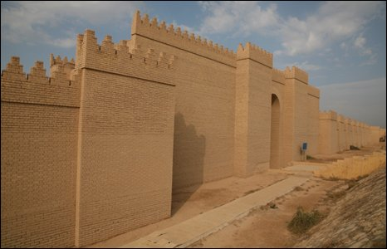
Walls of Babylon//Part of the Seven Wonders

Slide 15
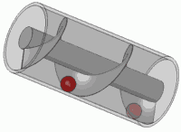
Archimedes Screw

Slide 16
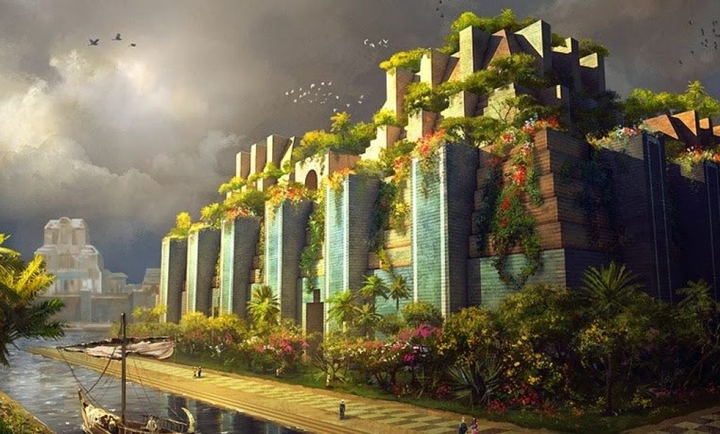
Hanging Gardens

Slide 17
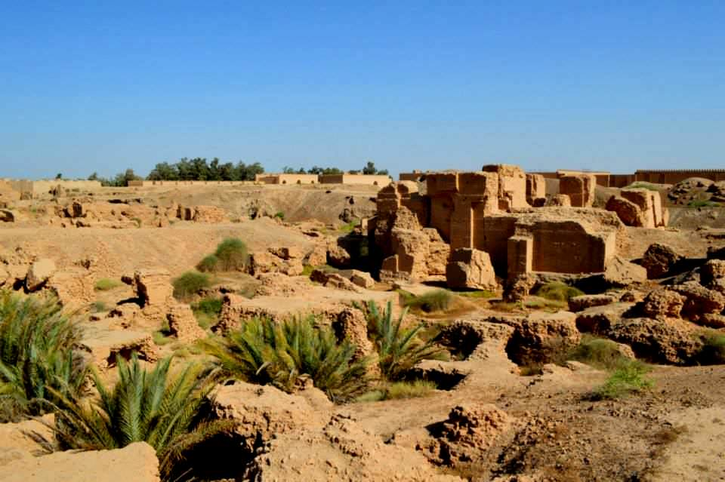
Hanging Gardens 2

Slide 18
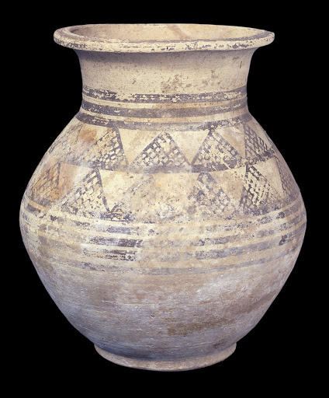
Assyrian Pottery

Slide 19
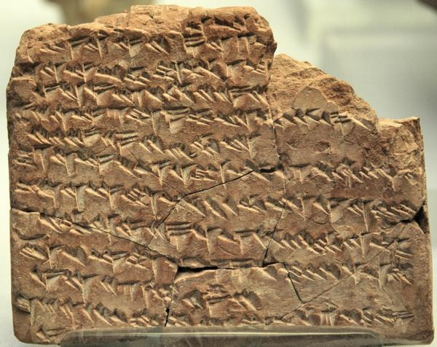
Astronomy: Wrote Observations Down

Slide 20
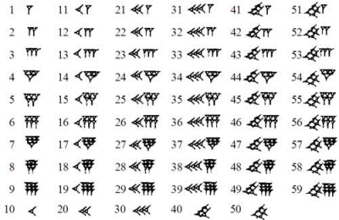
Mathematics

Slide 21
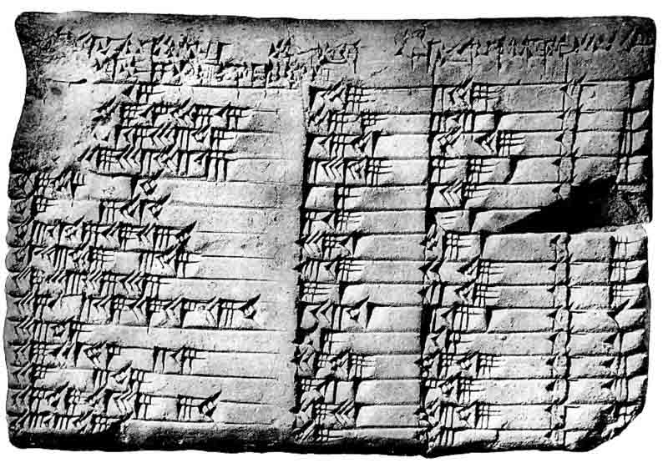
Mathematics Continued-- Plimpton 322

Slide 22
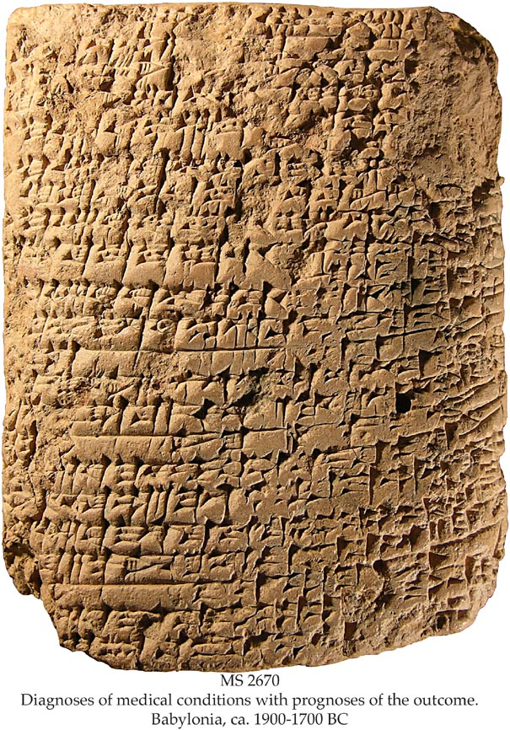
Medicine

